Slide 1
Kitchen Renovation

Slide 2
Introduction
Improve the structure by altering the kitchen layout.
Providing additional facilities.
Taking of measurements keenly to make sure the products fit into the place.

Slide 3
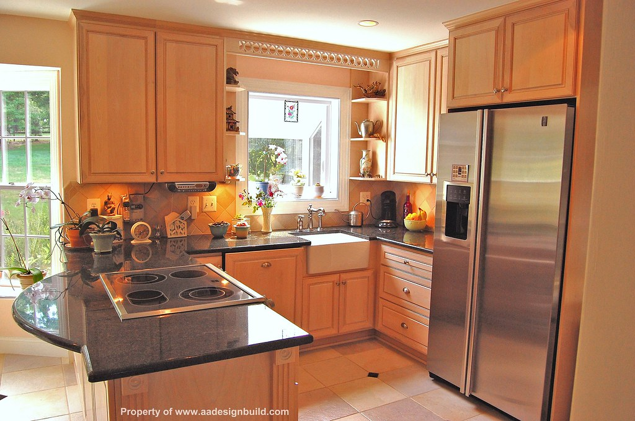
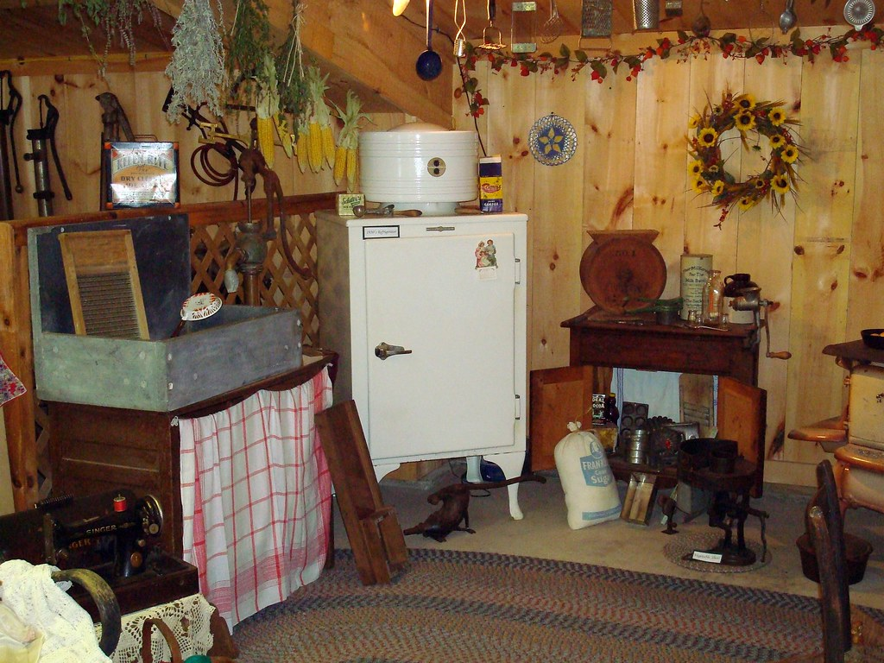
Photos of the kitchen.

Slide 4
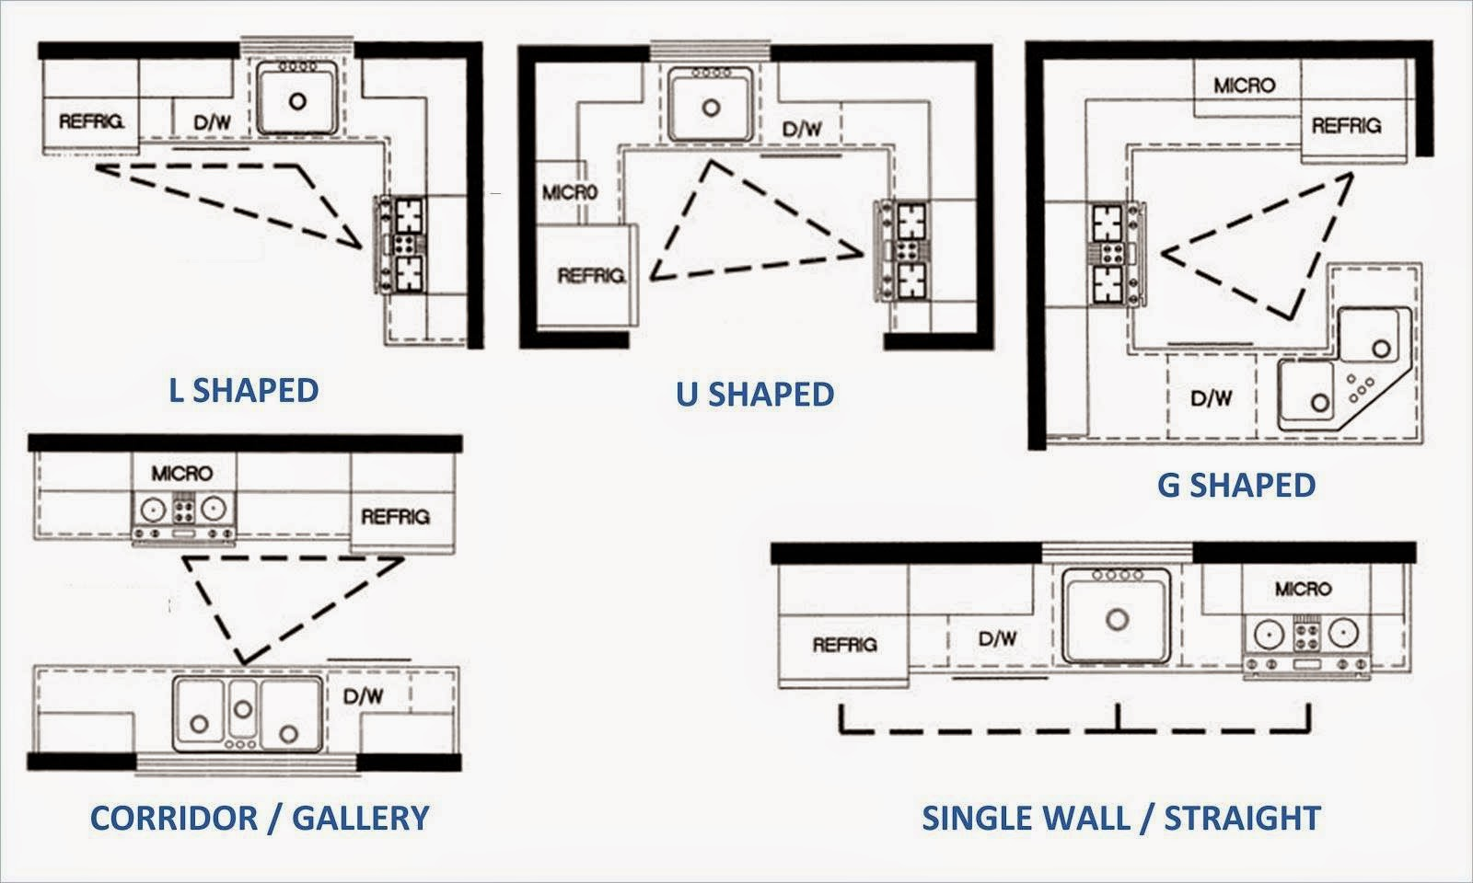
Prior Electronic Design
A minimum clearance aisle of 3’6” (1.07 m) is required in front of the L-Shape layout, with recommended widths from 4’-6’ (1.2-1.8 m). L-Shape Kitchens have long linear lengths that range from 8’-13’ (2.4-4 m) and short lengths of 3’-9’ (.9-2.7 m). L-Shape Kitchens should be planned with an overall area of roughly 111 ft2 (10.3 m2).

Slide 5
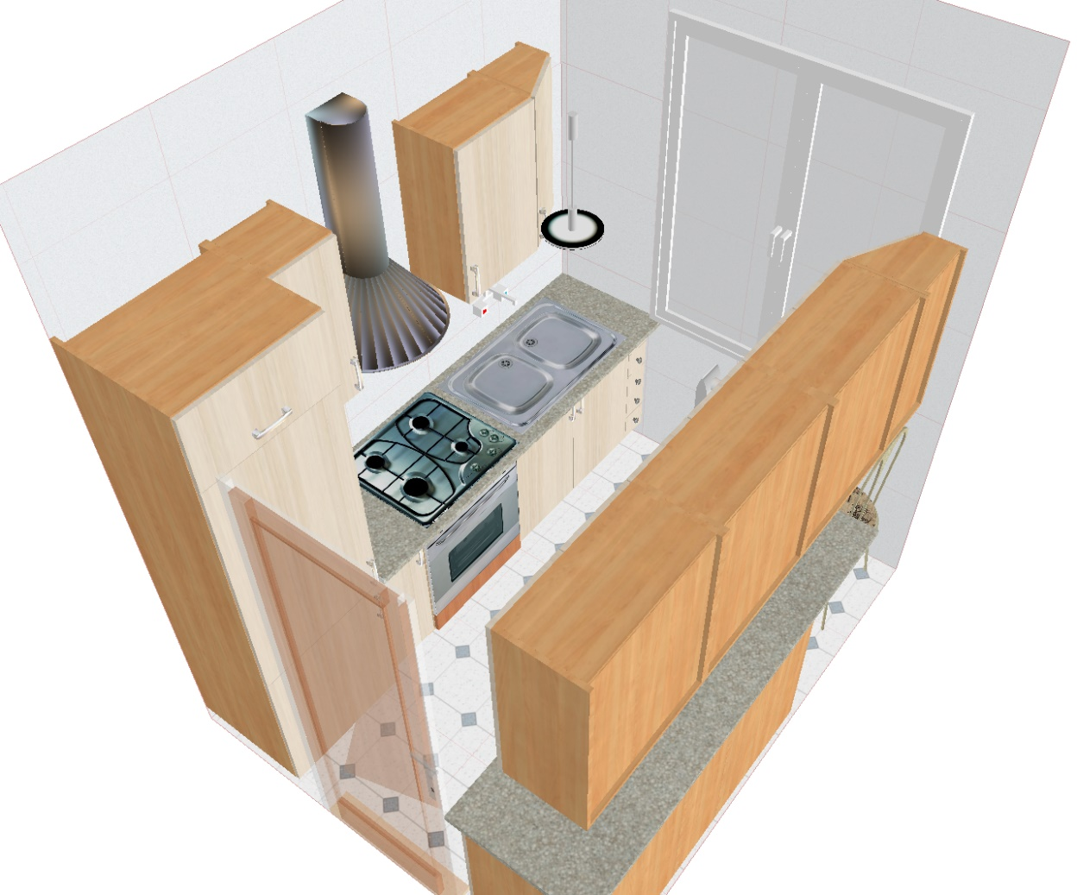
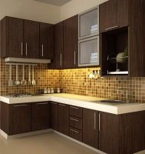
Modern Layout

Slide 6
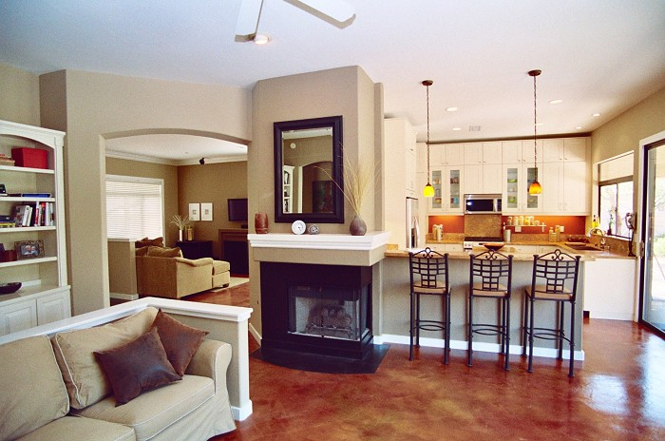
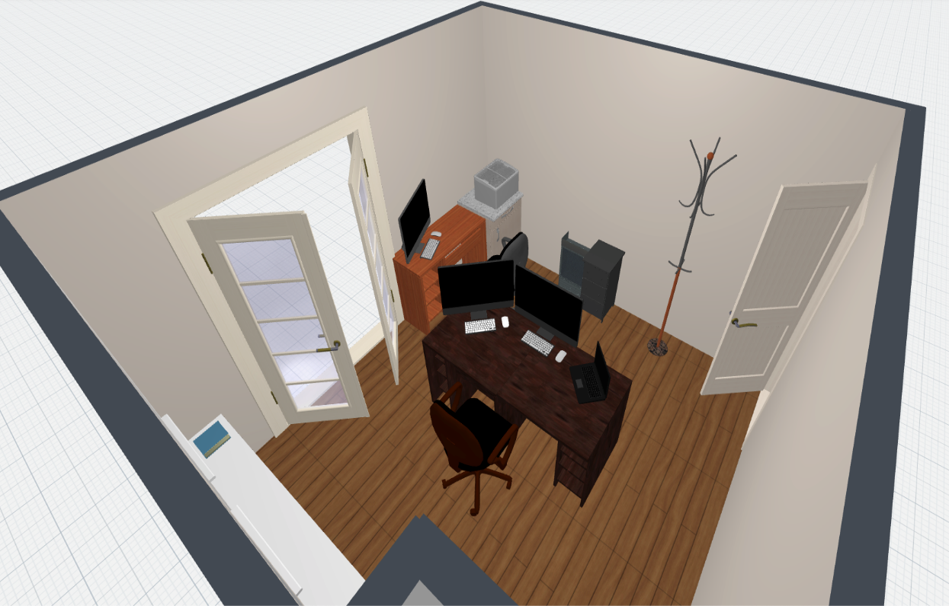

Slide 7
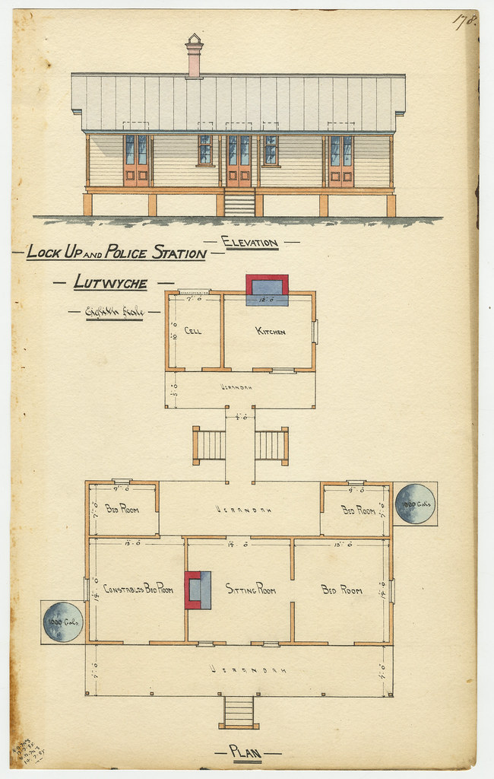
Electronic Design
The measurements are in L-Shape Kitchen Islands in which kitchen layouts I have used two adjacent walls, or an L configuration, to efficiently array the various kitchen fixtures around a rectangular island counter. Spatially flexible for multiple variations of lengths and depths, L-Shape Kitchen Island designs provide increased work space and table surfaces for kitchen activities.
A minimum clearance aisle of 3’6” (1.07 m) is required in front of an L-Shape layout, with recommended widths from 4’-6’ (1.2-1.8 m). L-Shape Kitchen Islands have long linear lengths that range from 8’-13’ (2.4-4 m) and short lengths of 3’-9’ (.9-2.7 m) and should be planned with an overall area of roughly 115 ft2 (10.7 m2).

Slide 8
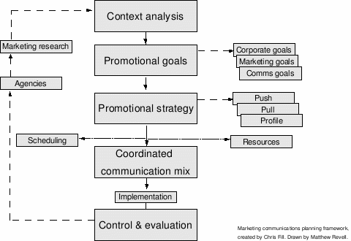

Modern kitchen proposal

Slide 9
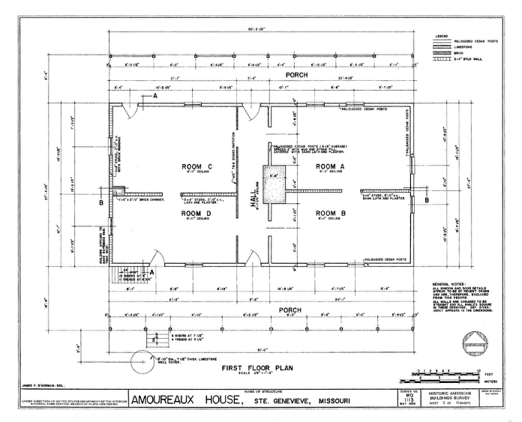
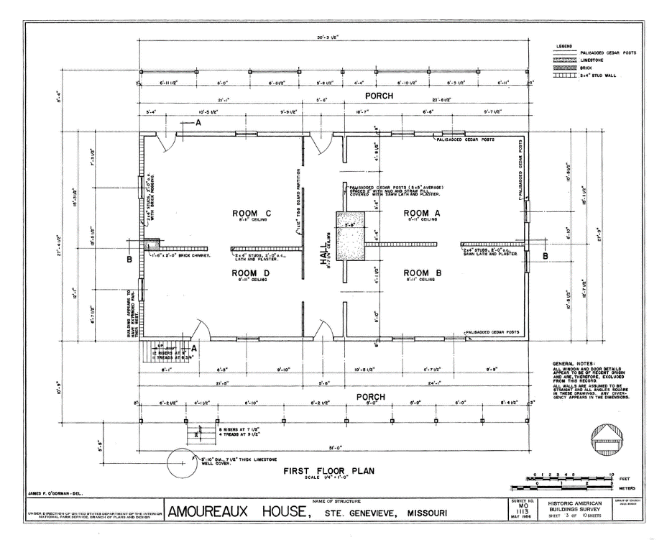
Proposed model

Slide 10
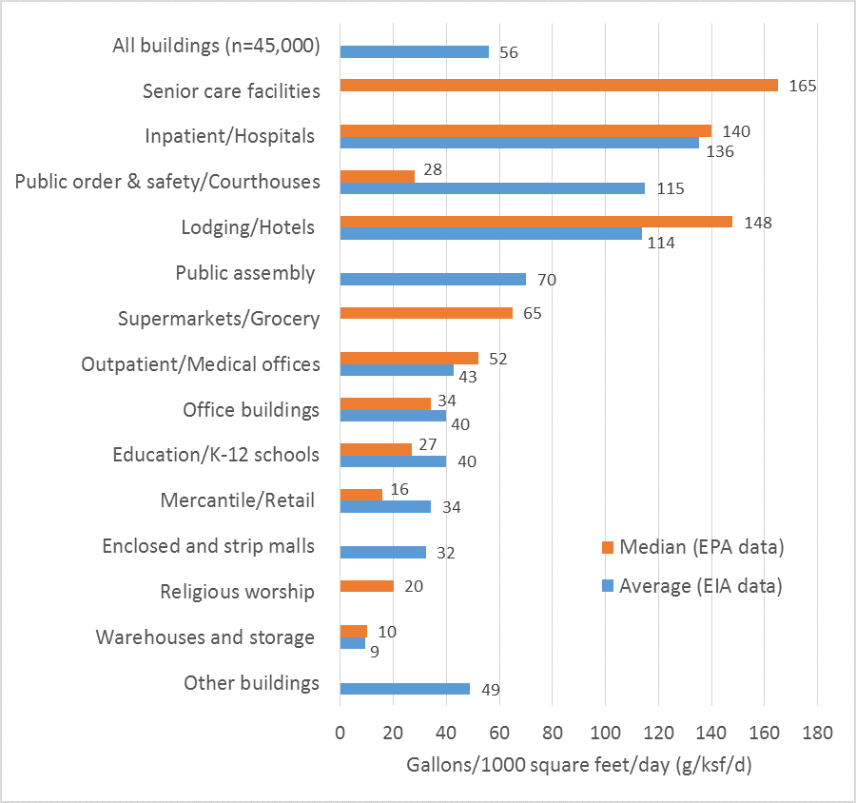
Calculations.

Slide 11
Conclusion.
The renovated kitchen with the electronic cookers provided a new appearance. The positioning of the chef’s office, windows and water tabs make it enhanced performance in terms on cooking.

